Slide 1

Internet Technologies
ITI & XI-IT
Lesson 2: JavaScript
Henrik Lange

Slide 2
Agenda
HTML & CSS recap
DOM Manipulation
When to use JavaScript
Where to put it
Events
Finding elements
Changing attributes
console.log
Timers
Variables
If-Then-Else
Operators
Arrays
Loops
Functions
Events
Objects
Strings
Numbers
Dates
RegEx

Slide 3
HTML & CSS Recap
Questions from last time:
Is HTML and CSS Turing complete?
Neither is on its own
Together, they can emulate a specific rule (Rule 110), which, by definition, makes them Turing complete.
Implementation: http://eli.fox-epste.in/rule110-full.html
Relies on per-cycle user-input
Hacks browser interpretation
Is it really turing complete?

Slide 4
HTML & CSS Recap
Questions from last time:
What about Internet Explorer?
IE reads specific HTML comment types as code:
<!--[if IE 6]>
Special instructions for IE 6 here
<![endif]-->

Slide 5
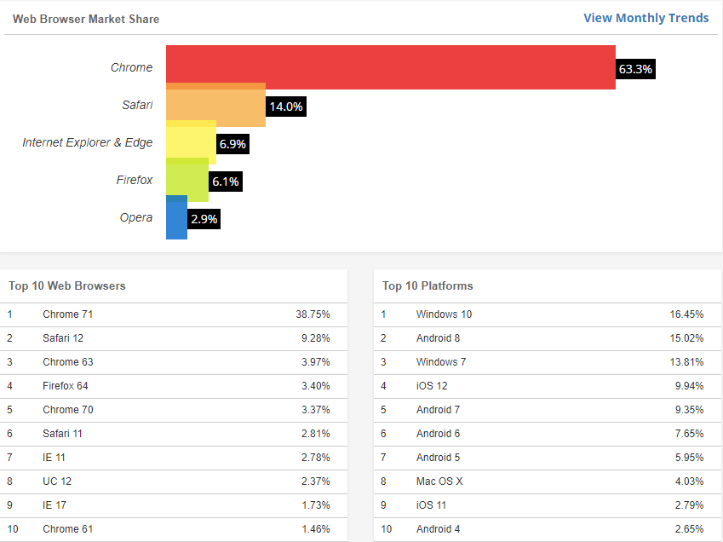
Source: https://www.w3counter.com/globalstats.php

Slide 6
HTML & CSS Recap
Questions from last time:
Which verbs are supported by HTTP
HTTP supports GET, POST, PUT, DELETE (and more)
HTML forms only support GET and POST
Using PUT or DELETE with HTML can be done using a workaround, such as this:
<input name=“_method” value=“put”/>
This requires servers side implementation

Slide 7
HTML & CSS Recap
Let’s see if it sticks!
http://fuzzball.nu/Projects/simplevote

Slide 8
REMINDER!
Since we will be ending with an exercise today, I want to remind everyone up front:
Please download and install PHP 7.3 from the following link:
https://windows.php.net/download#php-7.3
And MariaDB 10.3.12 from the following link:
https://downloads.mariadb.org/mariadb/10.3.12/

Slide 9
What is JavaScript
HTML, CSS & JavaScript make up the three languages you can expect any browser to interpret
JavaScript is loaded after the DOM is created from the HTML and CSS
The primary purpose is to change a site after it has loaded
JS can be used for other things (Unity, Node.js, etc.) but we will only look at it as the third front-end language.

Slide 10
When to use JavaScript
When you need to change the DOM after it has loaded
Responsive content
Dynamic loading
Enabling/disabling elements
Checking form content before submission
DOM will load and display before JavaScript is handled!
If CSS can handle it, LET CSS handle it!

Slide 11
A few JS facts
JavaScript is case-sensitive and has both // and /*..*/ comments.
JavaScript is another “curly bracket language” so if, if..else, switch, while, do..while, and for behave as you might expect.
JavaScript has all the “usual” arithmetic, relational, logical, and conditional operators: +, -, *, /, %, <, <=, >, >=, ==, !=, &&, ||, !, ? :
JavaScript arrays and strings start at index 0.

Slide 12
A few JS gotchas
JavaScript has dynamic typing, so a variable takes on the type of any value assigned to it.
Variables must be declared with a preceding var keyword if you want them to be local to a function.
JavaScript has Number, String, and Boolean as basic types.
Number has only double-precision floating point values, so (for example) JavaScript does not have “integer division”.
JavaScript strings can use double or single quotes.
=== and !== are preferred over == and != because they check both value and type.

Slide 13
Let’s edit a page locally
We can load any page and edit our local version
Edit the DOM directly
Edit or insert new CSS elements
Open any file that makes up the page and edit it
Write JavaScript directly in the console
We can use this to change our sites to perfection before we write the final code
We can see if all our files gets loaded
We can take someone elses design or outright copy content
We can use it for malicious purposes, such as…?

Slide 14
Where do we put it?
<!DOCTYPE html> <html> <head> <title>Title of the document</title>
<meta name="viewport" content="width=device-width, initial-scale=1.0">
<script src="myscripts.js"></script>
<link rel="stylesheet" type="text/css" href="style.css"> </head> <!--Comment--> <body> <h1>Header</h1>
<p>General content</p>
<a href="url">A link</a>
</body> </html>

Slide 15
Where do we put it?
<!DOCTYPE html> <html> <head> <script src="myscripts.js"></script>
</head> <body> <script>
//do something on load
function myFunction() {
//do something when function is called
}
</script>
<button onclick=“myFunction()”>Button</button>
</body> </html>

Slide 16
Where do we put it?
As with CSS, JavaScript should generally be put in different file, but as shown, there are different options.
The HTML <script> element can either point to a JavaScript file or contain JavaScript within it.
Non-functions called when DOM has loaded
Functions are called by triggers
Triggers can come from HTML attributes
<button onclick=“doSomething();”>
Attribute can contain code!
Triggers can be set directly in the JS
document.body.onkeydown = function(e) {}
document.getElementById('test').addEventListener(‘click', function() { });

Slide 17
HTML Event Attributes
Most common ones
onClick
onMouseDown
onMouseUp
onMouseOver
onMouseOut
onWheel
onKeyPress
onKeyDown
onKeyUp
onLoad
For forms
onFocus
onChange
onBlur
onSelect
onReset
onSubmit
Complete list:
https://www.w3schools.com/tags/ref_eventattributes.asp

Slide 18
HTML Event Attributes
Notice how the addEventListener method does not use the “on” part of the event name.
A function called from an HTML element can specify 2 parameters
Event
This holds further information about the event
If it’s an OnKeyDown event, the event knows which key was pressed
This
Contains the DOM object that called the function
<button onclick=“call(event, this)”></button>
<script>
function call(ev, obj) { }
</script>

Slide 19
Finding elements
document.getElementById(‘idA’); (1)
document.getElementsByClassName(‘classA’); (+)
document.getElementsByTagName(‘div’); (+)
document.querySelector('.classA.classB’); (1)
document.querySelectorAll('.classA.classB’); (+)

Slide 20
Changing attributes
document.getElementById(‘idA’).innerHTML = “Hello”;
document.getElementById(‘idA’).style.color = “red”;
var idA = document.getElementById(‘idA’);
idA.style.border = “1px solid grey”;

Slide 21
Changing attributes
element.innerHTML element. outerHTML
element. innerText element. outerText
element. style
Any css attribute is a child of “style”
document.createElement(“div”)
element.appendChild(element)
One element can only be in one place!
element.cloneNode(true)
element.insertBefore(newFirstElement, existingElement)

Slide 22
Special functions
console.log(“A little something for the console”);
alert(“Some important message for a user”);
Note that these can (will) be disabled by users
confirm(“Are you sure?”)
Can be used in if-statements
<p id="a">Click the button.</p>
<button onclick="myFunction()">Try it</button>
<script>
function myFunction() {
if(confirm(“Are you sure?")) {
document.getElementById("a").style.color = "blue";
} else {
document.getElementById("a").style.color = "red";
}
}
</script>
Date.now()

Slide 23
Special functions
Date.now()
setTimeout(function, milliseconds);
Will execute x milliseconds after being called
setInterval(function, milliseconds);
Will execute in a loop with x milliseconds between iterations

Slide 24
Variables
JS variables have no explicit types
Types are inferred on declaration
Assigning a new value of a different type will change the type
Assignment is done with =
const, var & let
const can not be altered after initial assignment
let will give you error messages
let number = “5”;
number = parseInt(number);
>> 5

Slide 25
Variables
Variables can contain any datatype, including
Strings
Integers
Decimal numbers
Arrays
Functions
Objects
let doubler = function(number) { return number*2; }
doubler(4)
>> 8

Slide 26
Arithmetic and comparisons
Same arithmetic operators as Java:
+ - * / % ++ -- += -=
< <= > >= == != && || !
=== and !== check both type and value
1 == “1” >> true
1 === “1” >> false

Slide 27
Functions
Functions and methods are two words for the same thing
Since variable types are not declared, return types and parameter types are not declared either
function plus2(number) { return number+2; }
plus2(2); >> 4 (int)
plus2(2.2); >> 4.2 (double)
plus2(“2”) >> “22” (string)
let plus2 = function(number) { return number+2; }
Creates the same method
Multiple parameters possible

Slide 28
Objects
let person = {
name : “Jackie Chan”,
birthyear : 1954,
age : function() {
return 2019 – 1954;
}
}
person.age() >> 65
person.name >> “Jackie Chan”

Slide 29
If-Then-Else
if(2 + 2 == 5) {
debug.log(“Browser malfunction”);
} else if (2 + 2 === 4) {
debug.log(“Hope remains”);
} else {
debug.log(“Sadness ensues”);
}

Slide 30
Switch
switch (new Date().getDay()) { case 0: day = "Sunday"; break; case 1: day = "Monday"; break; case 2: day = "Tuesday"; break; case 3: day = "Wednesday"; break; case 4: day = "Thursday"; break; case 5: day = "Friday"; break; case 6: day = "Saturday"; }

Slide 31
Arrays
let array = [1, “b”, [2, 4]];
array.length; >> 3
array[2].length >> 2

Slide 32
Loops
for (i = 0; i < cars.length; i++) { text += cars[i] + "<br>"; }
for (x in person) { text += person[x]; }
while (i < 10) { text += "The number is " + i; i++; }
do { text += "The number is " + i; i++; } while (i < 10);
break;
Exits loop
continue;
Skips to next round of loop

Slide 33
Comments
//comment until end of line
/*multiline comment*/

Slide 34
Form validation example
<form onsubmit="return checkFields()” method=”post” action=”this.html” >
<label for="name" style="color: blue;">name</label>
<br>
<input type="text" name="name" id="name"/>
<br>
<input type="submit" name="submit" id="submit"/>
</form>
<script>
function checkFields() {
var password = document.getElementById("password").value;
if(password.length < 8) {
alert("Password must be at least 8 characters");
return false;
} else {
return true;
}
}
</script>

Slide 35
Form validation
Note that we use onsubmit
Note that we use return inside onsubmit
Prevents form from posting when false is returned
We could use onkeydown | onkeyup in each field to check response while writing
We could use onblur to check after each field is left

Slide 36
Form validation
Note that we use alert
Alerts can/will be disabled by users
Alerts make a bad user experience
Alternatives:
Color the input field green or red depending on input
Make an empty div under each input to write errors in
Make a common div somewhere and put all errors in that

Slide 37
Regular Expressions
RegEx describes a character pattern
Used to perform pattern-mathing
Format: /pattern/modifier
E-mail example: /\S+@\S+\.([a-z]|[A-Z]){1,5}/g
Try your own on https://regexr.com/
Reference: https://www.w3schools.com/jsref/jsref_obj_regexp.asp

Slide 38
Regular Expressions
Modifiers
g : global match
i : case-insensitive match
m : multiline match
Expression
[abc] : match any character mentioned
[^abc] : find any character NOT mentioned
[0-9] : match any char between values
(a|b) : find any alternative (a or b)
Example: ([a-z]|[0-9])

Slide 39
Regular Expressions
Quantifiers
n+ : one or more
n* : zero or more
n? : zero or one
n{x} : x occurrences
n{x,y} : between x and y occurrences
n{x,} : at least x occurrences
n$ : any string that ends with n
^n : any string that starts with n
?!n : any string that does not end with n

Slide 40
Regular Expressions
Metacharacters
. : single character, except newline or line terminator
\w : a word char
\W : non-word char
\d : digit
\D : non-digit
\s : whitespace
\S : non-whitespace
\n : newline character
\r : carriage return character
\t : tab character

Slide 41
How to use it
var testable = “test this";
var regex = new RegExp(“/([a-z0-9]{5,})/g");
if (regex.test(testable)) { … }
or
/([a-z0-9]{5,})/g.test(testable)

Slide 42
Exercise
Task
Template
Name
Two or more words, separated by whitespace
Password
Contains 8 or more chars
At least one lower case char
At least one upper case char
At least one number
Phone number
Starts with a “+”
Has between 8 and 30 digits
Email
some.name@sub.domain.whatever
Zip-code
Is exactly 4 digits
<form action=”this.html” method="post">
<label for="name" style="color: blue;">name</label>
<br>
<input type="text" name="name" id="name"/>
<br>
<label for="password">password</label>
<br>
<input type="password" name="password" id="password"/>
<br>
<label for="phone">phone number</label>
<br>
<input type="text" name="phone" id="phone"/>
<br>
<label for="email">email adress</label>
<br>
<input type="text" name="email" id="email"/>
<br>
<label for="zip">zip code</label>
<br>
<input type="text" name="zip" id="zip"/>
<br>
<input type="submit" name="submit" id="submit"/>
</form>

Slide 43
Another Exercise
Cat & Mouse
Make a simple game
Each element is a simple square
A blue square (the mouse) is controlled by the arrow keys on the keyboard
A red square (the cat) moves towards the mouse at all times
Two or more orange squares (cheese) are spread on the screen
When the mouse touches a piece of cheese, it disappears
When all cheese is gone, the mouse has won
When the cat touches the mouse, the mouse has lost
Extra challenge: pause/unpause with “p”

Slide 44
Have fun with it
Before next time, please download and install PHP 7.3 from this link:
https://windows.php.net/download#php-7.3
And MariaDB 10.3.12 from the following link:
https://downloads.mariadb.org/mariadb/10.3.12/

